Slide 1
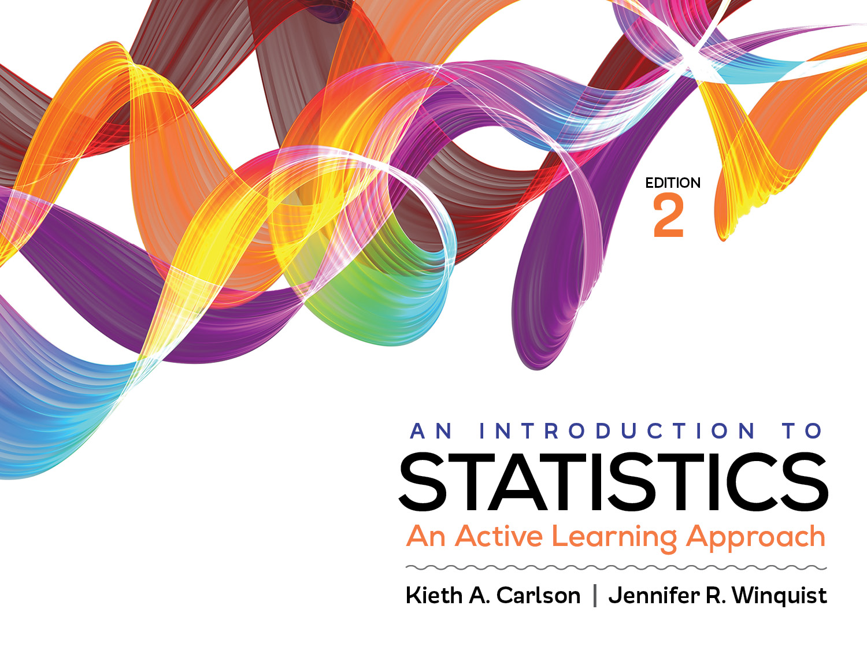
Activity 10.2
A two-tailed independent t test

Slide 2
Activity 10.2 will require you to:
Use SPSS to compute and interpret an independent t test
Work through all 6 steps of an independent t test hypothesis test
Use the Levene’s test provided by SPSS to assess the homogeneity of variance assumption
Find errors in APA style write-ups

Slide 3
What values is the Levene’s test comparing?
What is the correct obtained t value to report and why?
Notes:
Levene’s test compares the variability within each of the groups. If the variability is very different you will reject the null of this test.

Slide 4
What needs to be in an APA style summary?
Descriptive statistics for each group
Pattern of the means (which group, if any, was better)
Significance test statistical information
Effect size statistical information
Confidence intervals (in later assignment)
Identify the first 4 components in the following report.
Those getting treatment 2 (M = 15, SD = 5) scored higher than those getting treatment 1 (M = 10, SD = 4), t (20) = −2.59, p < .05, d = −1.10.

Slide 5
What is wrong with each of the following reports?
There was a significant difference between men and women on competitiveness, t (26) = 2.7, p < .05, d = .5.
There was not a significant difference between 8th and 12th graders on the amount of time they spent using social media, t (88) = .66, p > .05.
Those experiencing the training program (M = 11, SD = 5) made fewer errors than those in the control group (M = 15, SD, =7).
Notes:
It does not indicate which group was more competitive; it should include the means and SDs for each group in the report.
It should include the means and SDs for each group in the report.
It should include the statistical information, t (df) = obtained t, p, d.

